Slide 1
PATIENT JOURNEY what it is and why it matters

Slide 2
?
pertussis
convulsiva

Slide 5
TYPICAL BREAST IMAGING WORKFLOW
Ø 14 days
Ø 23 days
Screening
Diagnosis
Ultrasound
Biopsy
Patient organizes Appointment with Oncologist or Surgeon
reasons for avoiding timely screening
pain, discomfort
complex, time-consuming
stress, uncertainties, anxiety
➔ only 59% participate regularly (US survey; Bravo M, 2019)
Delaying treatment from two weeks to more than six weeks can lower the 5-yr. survival rate of breast cancer patients by as much as 10%. (Caplan L, 2014)
REF: Sedgwick E, et al (2019)

Slide 6
NEW BREAST IMAGING WORKFLOW
engage with patients and families
hone talent and ensure staff acceptance
implement patient-friendly technology
standardize protocols
optimize image interpretation
Screening
Diagnosis
Ultrasound
Biopsy
Specialists’ Appointment
1
day
contact
REF: Sedgwick E, et al (2019)

Slide 7
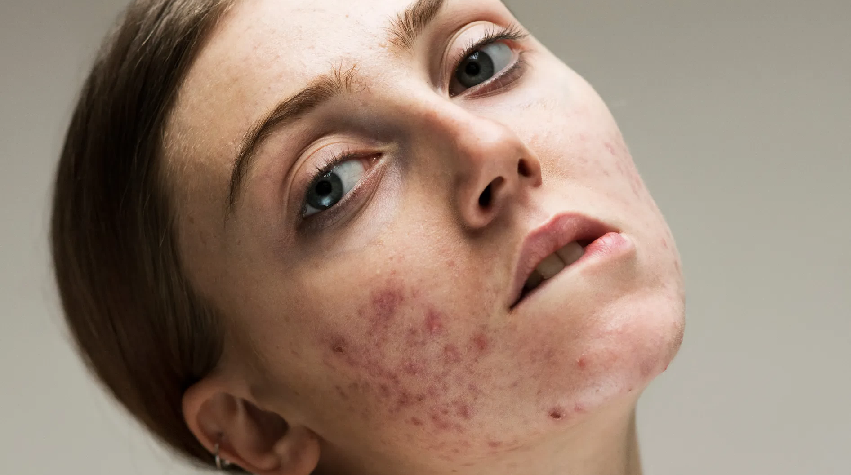
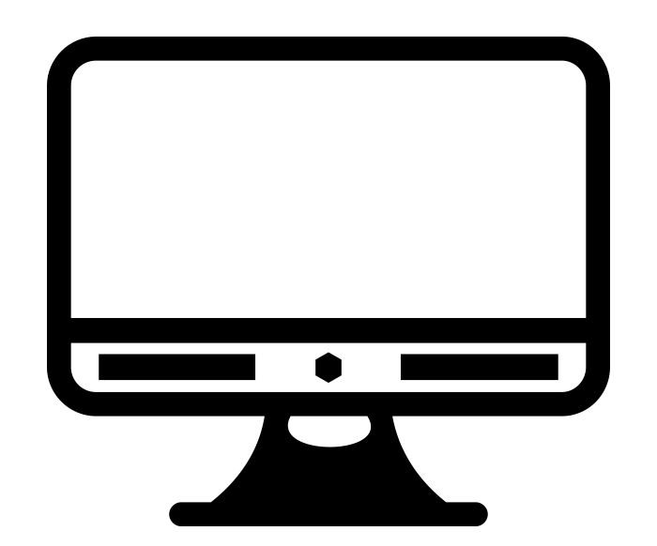
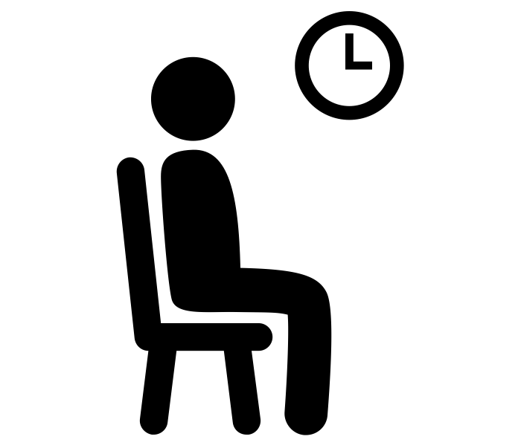
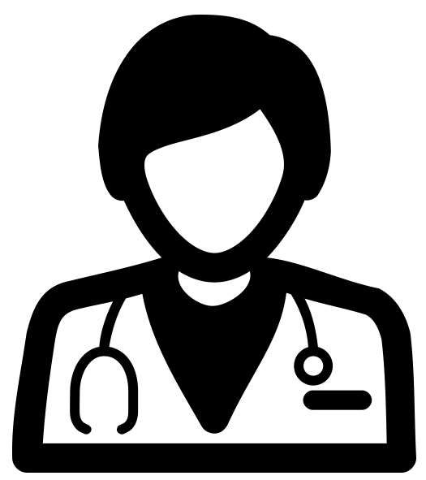
TYPICAL PATIENT JOURNEY: SKIN DISORDER (Danmark)
76% wrong
2-8 weeks
50% wrong
online search
F&F
?
trial
period
3 months
DERM.
REF: LEO Innovation Lab (2020)

Slide 8
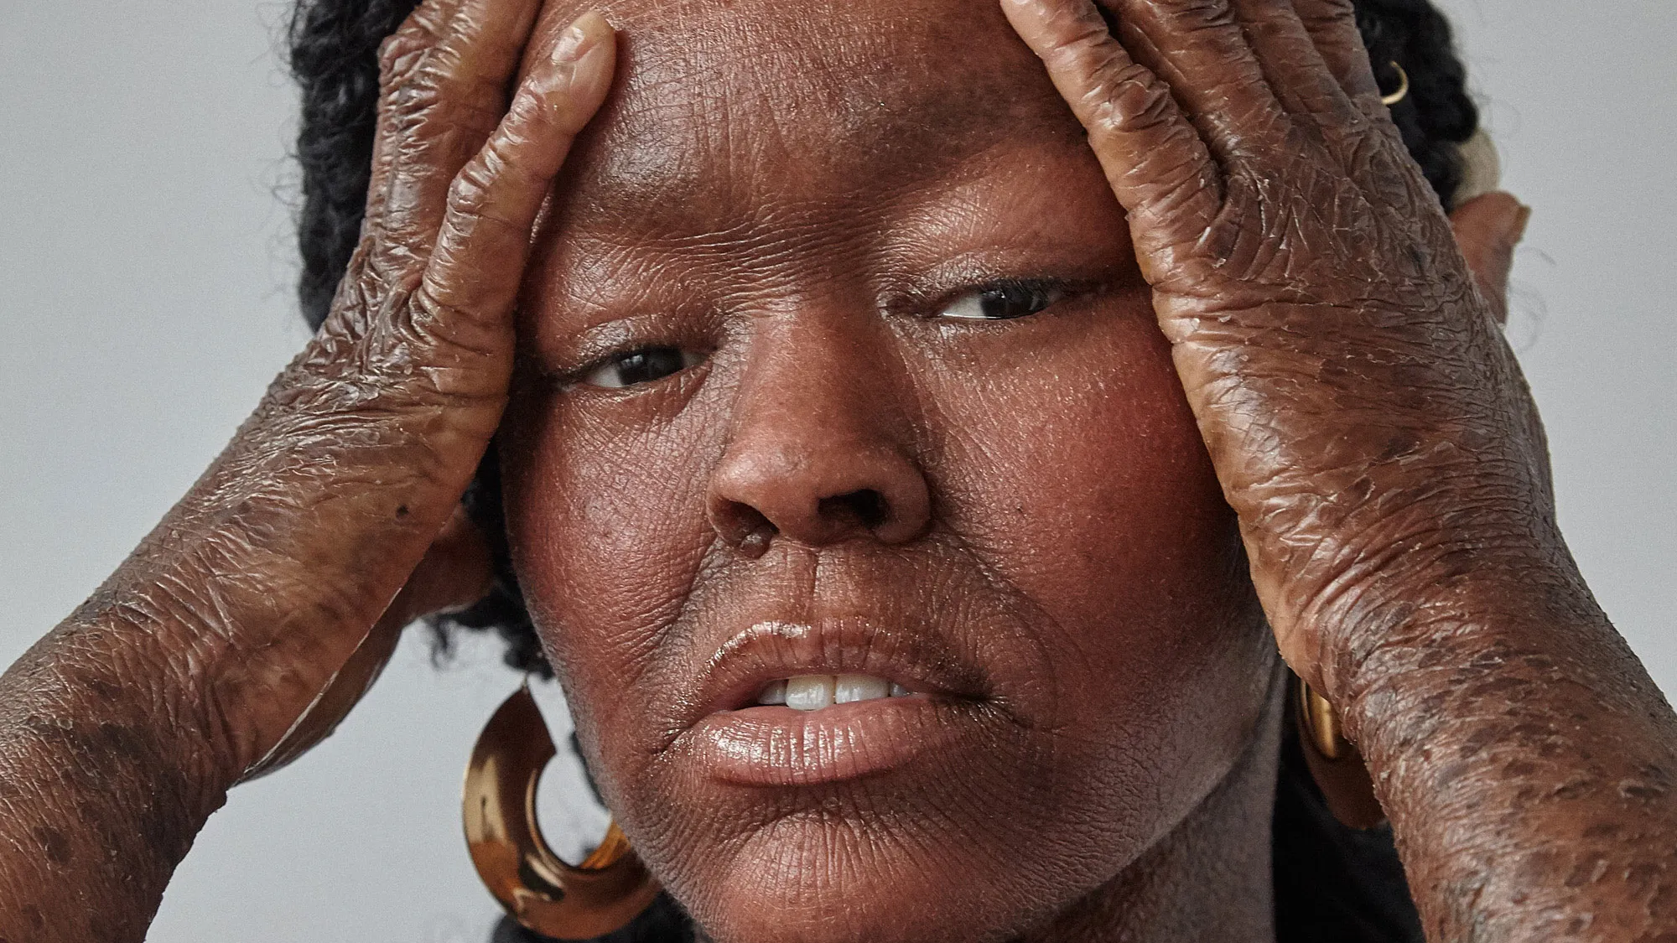
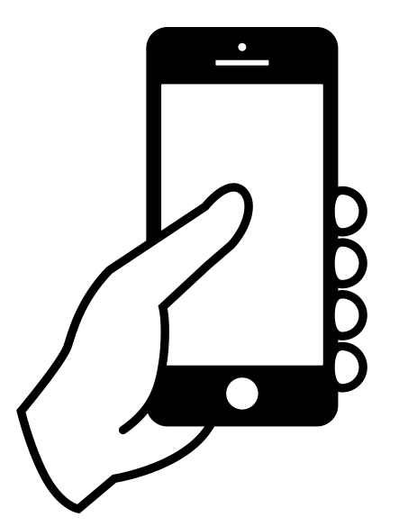
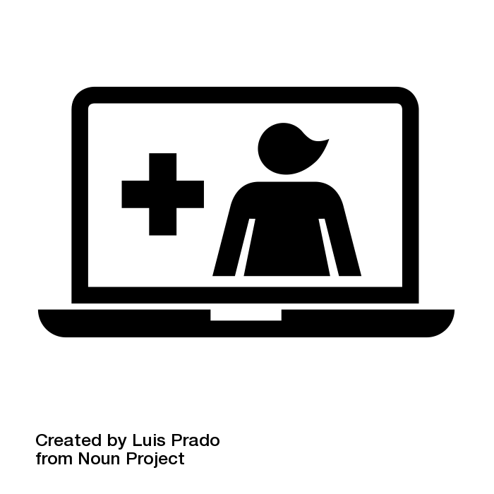
NEW PATIENT JOURNEY: SKIN DISORDER (Danmark)
skin disorder
60%
30%
10%
DERM.
DERM
REF: LEO Innovation Lab (2020); PIC: J. Gary

Slide 9
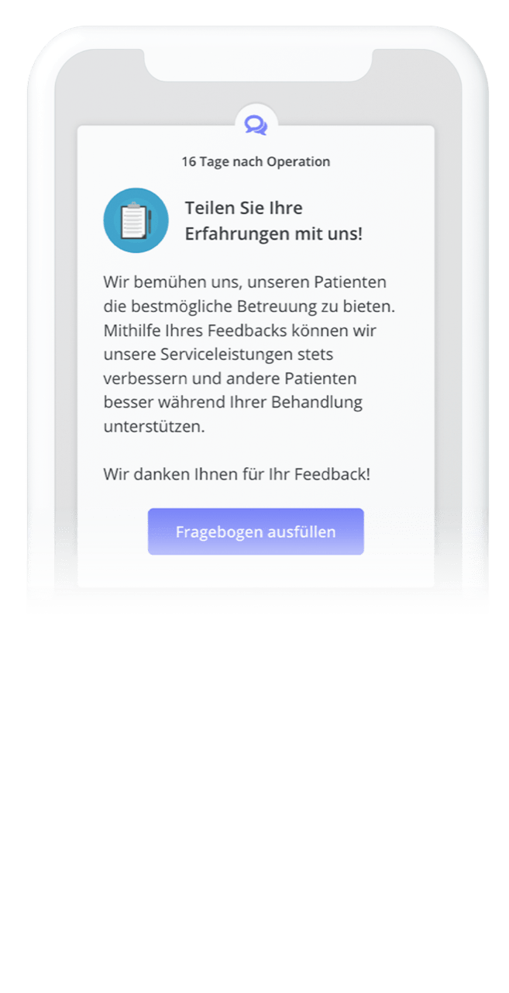
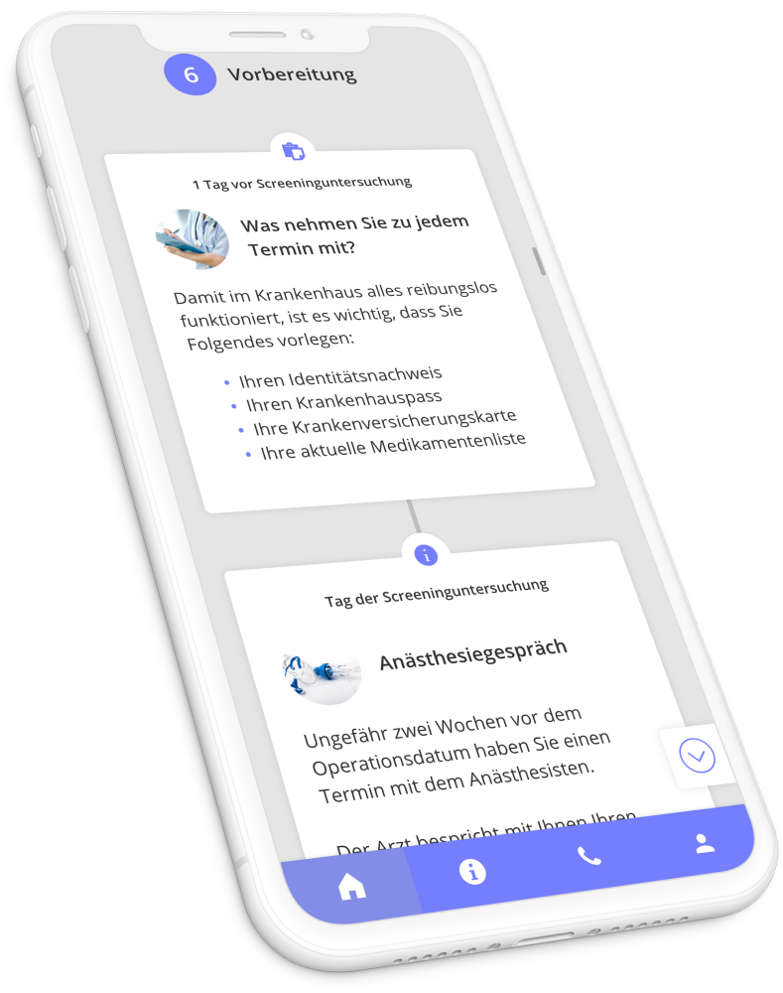
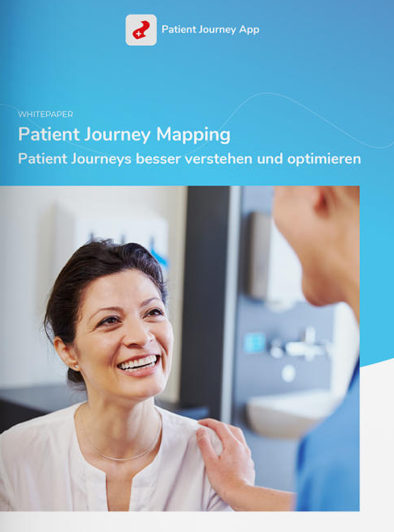
REF: Interactive Studios BV (2021)

Slide 10
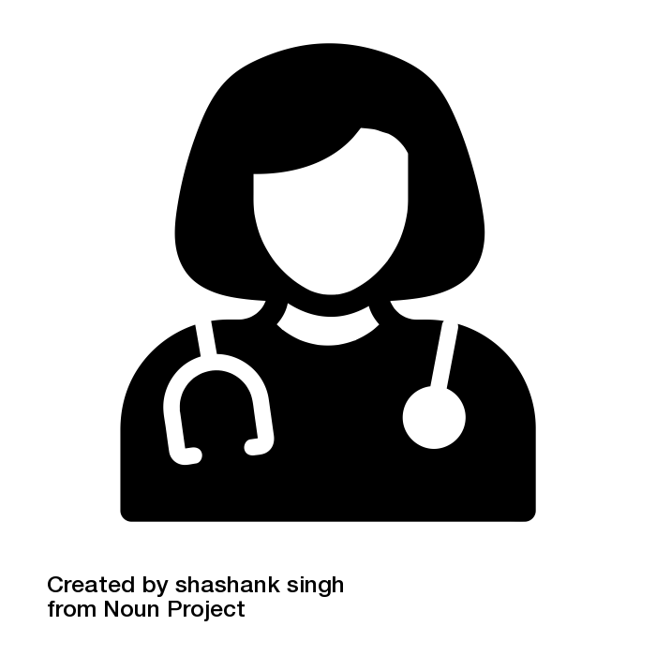
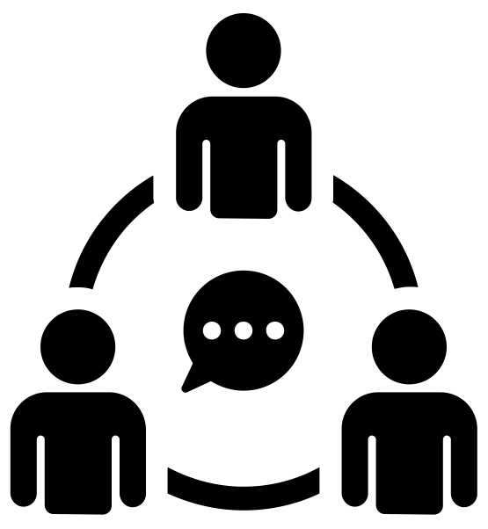
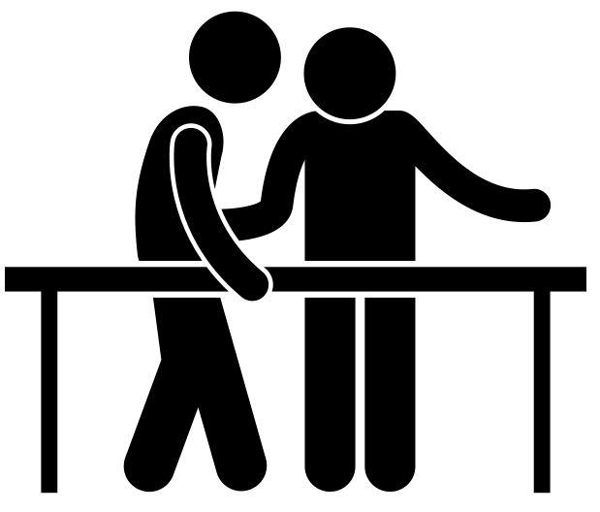
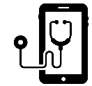
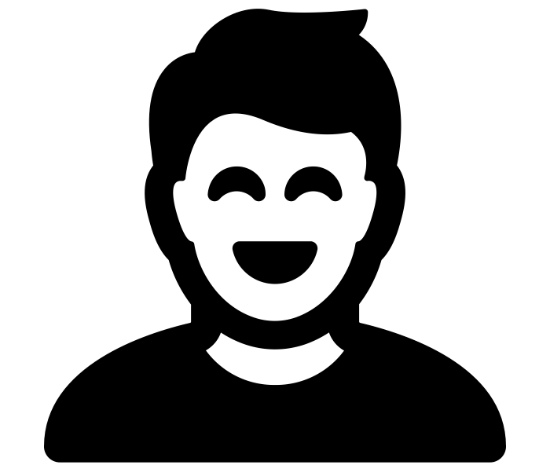
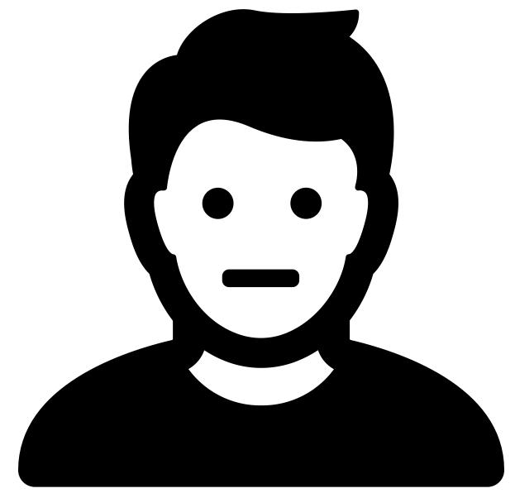
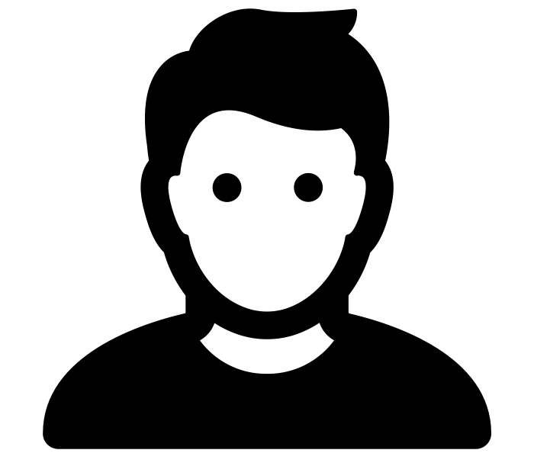
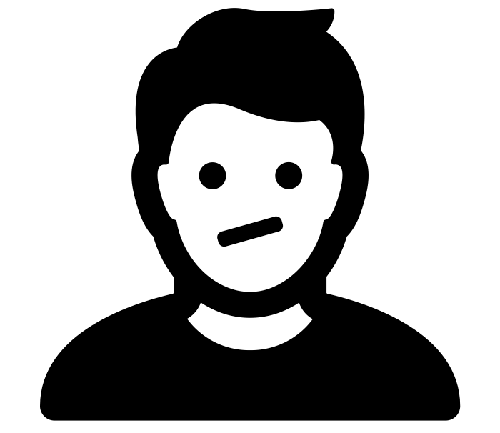
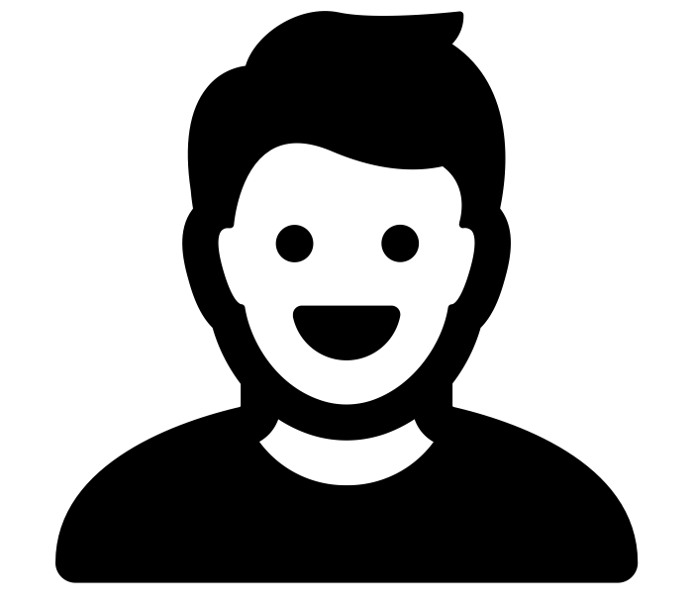
SCHULTHESS CLINIC, Zurich (REF: S. Lienhard)
WELLNESS, PREVENTION
SYMPTOMS, ILLNESS
DIAGNOSIS,
TREATMENT PLAN
THERAPY, TREATMENT
POST-TREATMENT & REHABILITATION
HOMECARE,
PALLIATIVE CARE
person is happy and healthy, checks sporadically about fitness and health topcis… | develops some symptoms and pain, searches the web, visits a check-up or family doc… | pre-triage, online check-in / consultation, digital doc / platform / telemedicine… | undergoes conservative therapy or surgery | transfer to rehabilitation-center or at home, visits clinic for follow-up checks… | Patient (health consumer) has successfully completed rehabilitation and is…
social media, www, family, friends, colleagues… | google, social media, webMD, Oscar; Healthline; Outcome Health; etc. family, friends… | family doc., insurance carrier, clinic admin. staff, via website, app, social media… | personal contact with HCP’s and other staff members, other patients, may be… | HCP’s and staff members, pharmacists, physio-therapists, admin. staff… | app, social media, newsletter, events, search-, evaluation- and comparison-platforms…
easily understandable health information | testimonials, references, statistics, literature, forums, meets other patients… | online booking and check-in, meets HCP’s and staff… | positive patient experience on site… | follow-up care, offer help, individual care program… | personalized information, tips and tricks, enable access for simple exchange and con…
Which information/source is reliable? | How do I find the best treatment / HCP’s? | insecurity, paperwork | Went everything well? What can I do? Boredom, insecurity, pain… | painful rehabilitation, repeated visits to the clinic, everyday life is cumbersome… | rehab does not provide results, multiple interaction with clinic and HCP’s…
PATIENT SITUATION
TOUCH-POINTS
GAINS
PAINS
happy
frustrated
hopeful-insecure
scared
relieved-confident
satisfied-happy

Slide 11
DO-IT-YOURSELF
MEDICINE
Gmeinder M, Morgan D, Mueller M (2017)
How much do OECD countries spend on prevention? OECD Health Working Papers, #1010, Paris. OECD Publishing, https://doi.org/10.1787/f19e803c-en

Slide 12
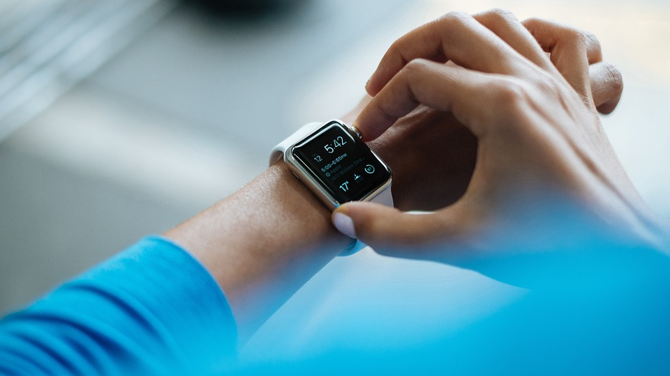

Slide 13
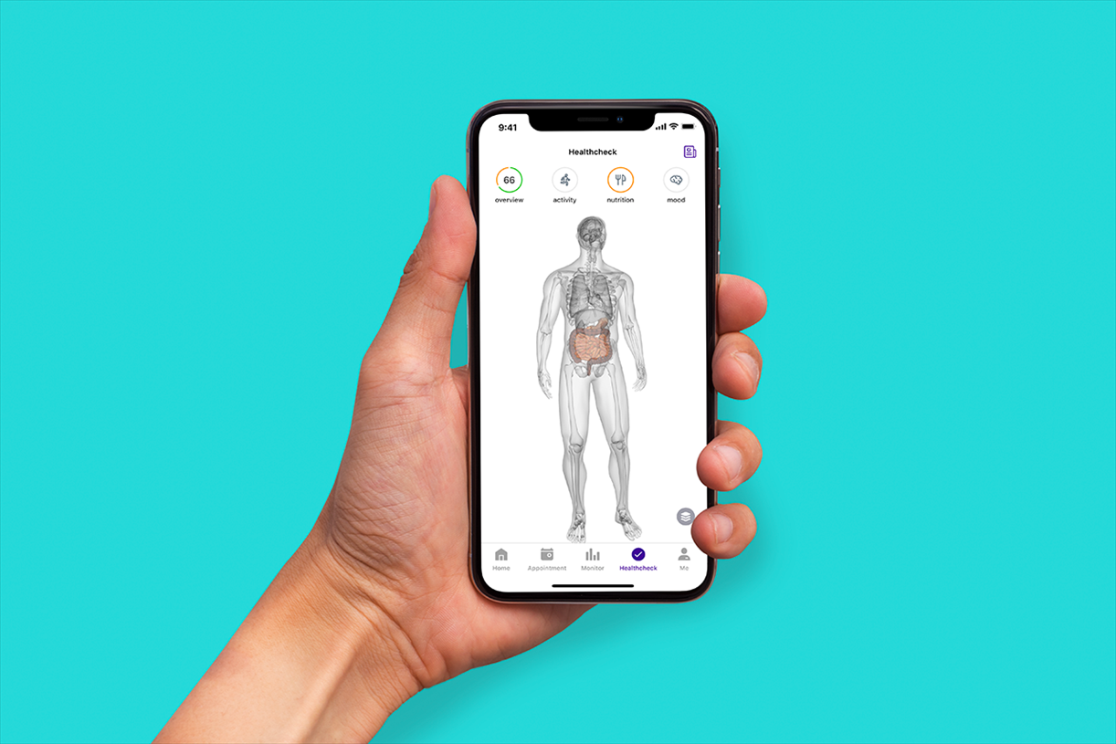
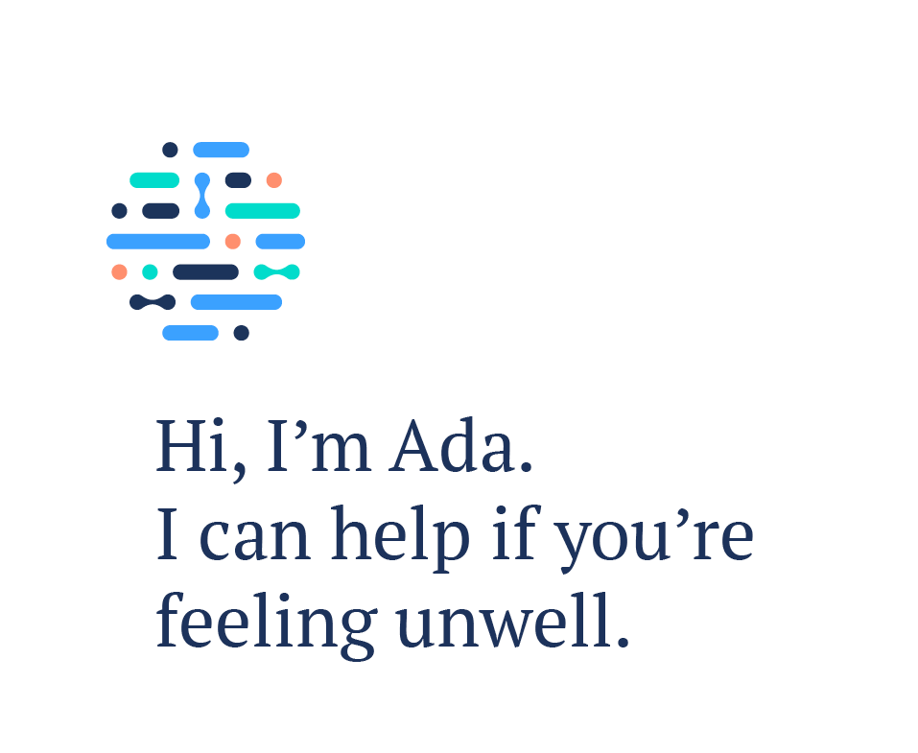
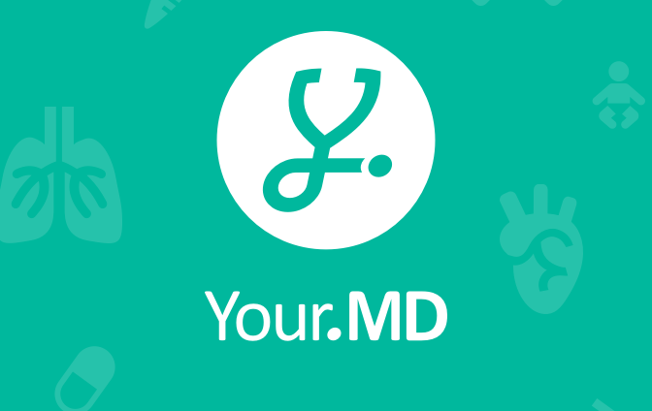
SELF-HELP/-DIAGNOSIS

Slide 14
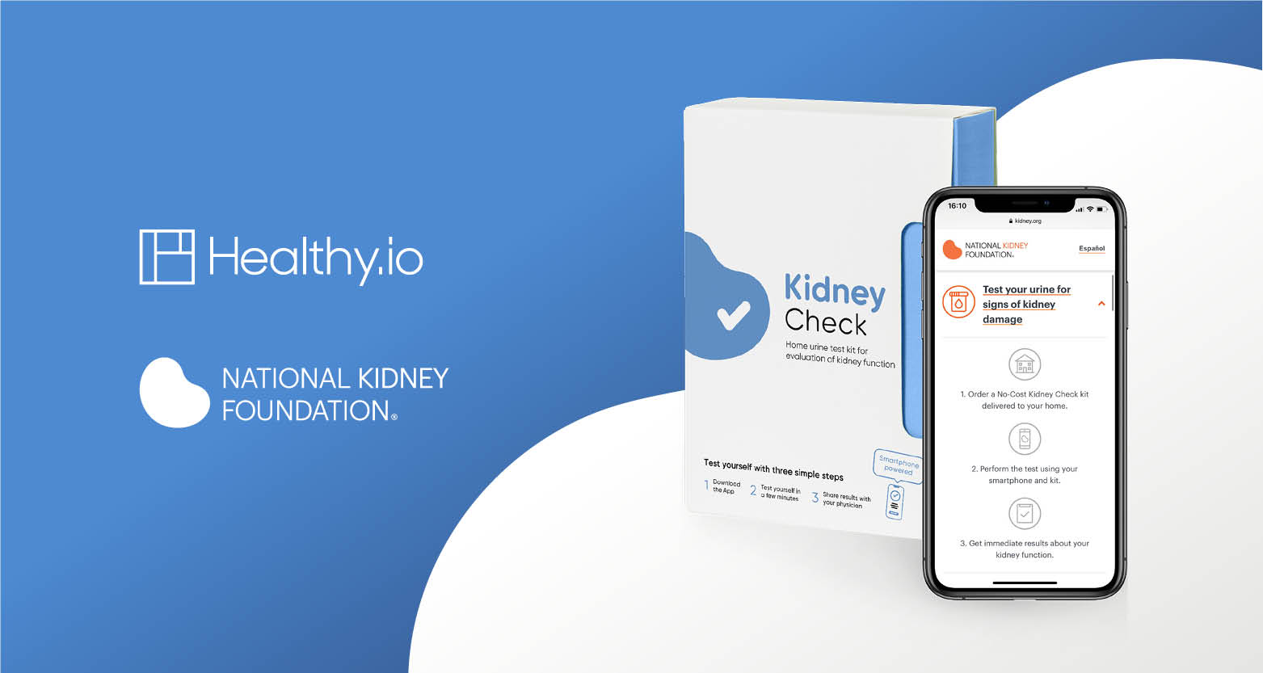
DO-IT-YOURSELF TESTS

Slide 15
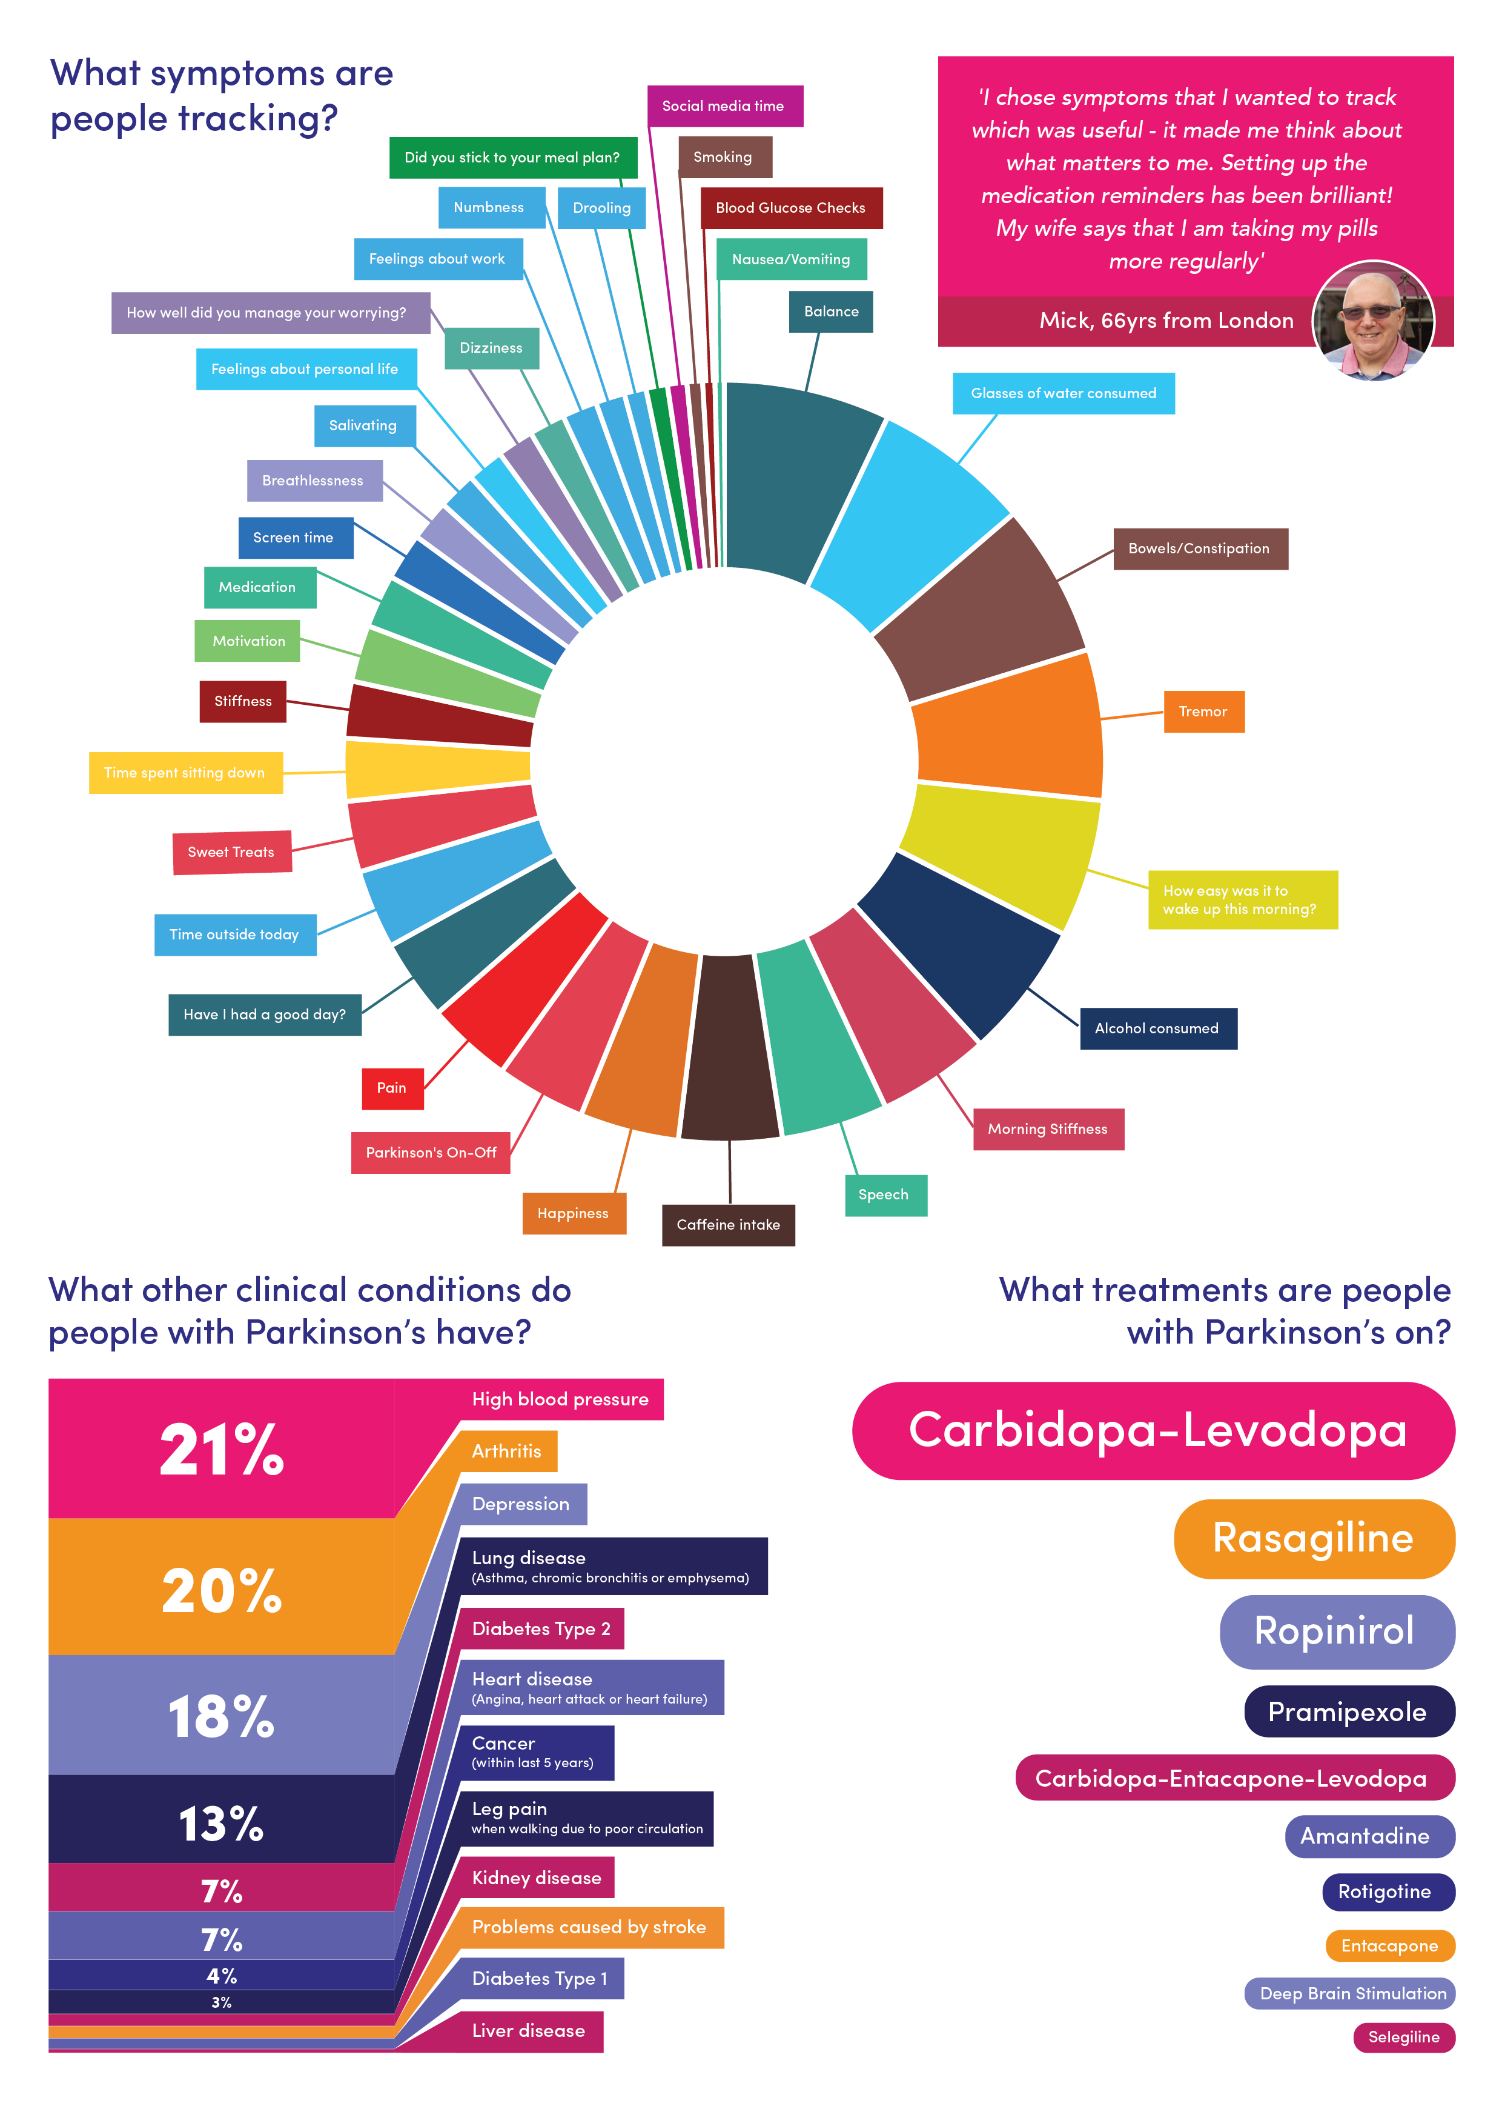

Slide 16
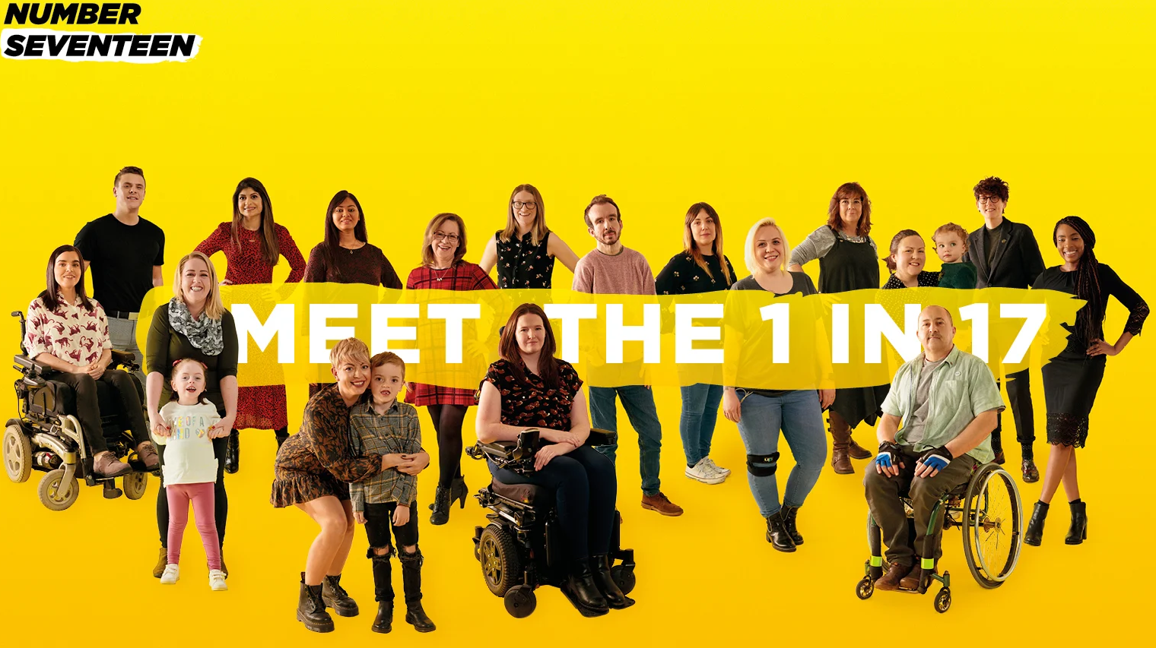
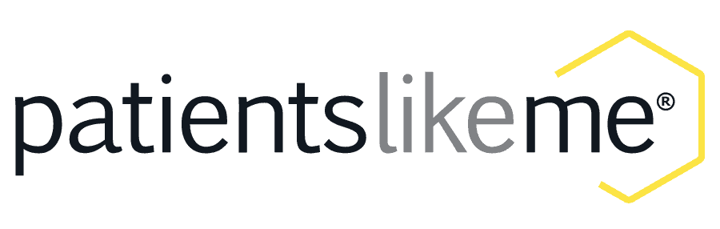
RARE DISEASES

Slide 17
DOCTOR - PATIENT
RELATIONSHIP
Re-allocation of Roles
Patients Gain Power – and Responsibility Topol E. (2015): The Patient Will See You Now: The Future of Medicine is in Your Hands. New York; Basic Books p. 33

Slide 18
Hong Y A, et al (2019)
What Do Patients Say About Doctors Online? A Systematic Review of Studies on Patient Online Reviews.
J of Medical Internet Research, 21(4), el2521

Slide 19
ONLINE CONSULTATIONS
Reasons for the fast growth of online-medical consultations¹
³ I would use online- medical consultations only if…
…it is free-of-charge. 79%
…the sound and video quality is high. 76%
…I know the Doctor. 72%
³ Thaller T, Acay O (2021)
convenience / privacy / 2nd opinion
shift toward care-intensive NCD’s²
higher cost efficiency
¹ Singh A P, et al (2018)
²NCD’s = Non-Communicable Diseases
cardiovascular disease
respiratory disease
diabetes
cancer
mental illnesses

Slide 20
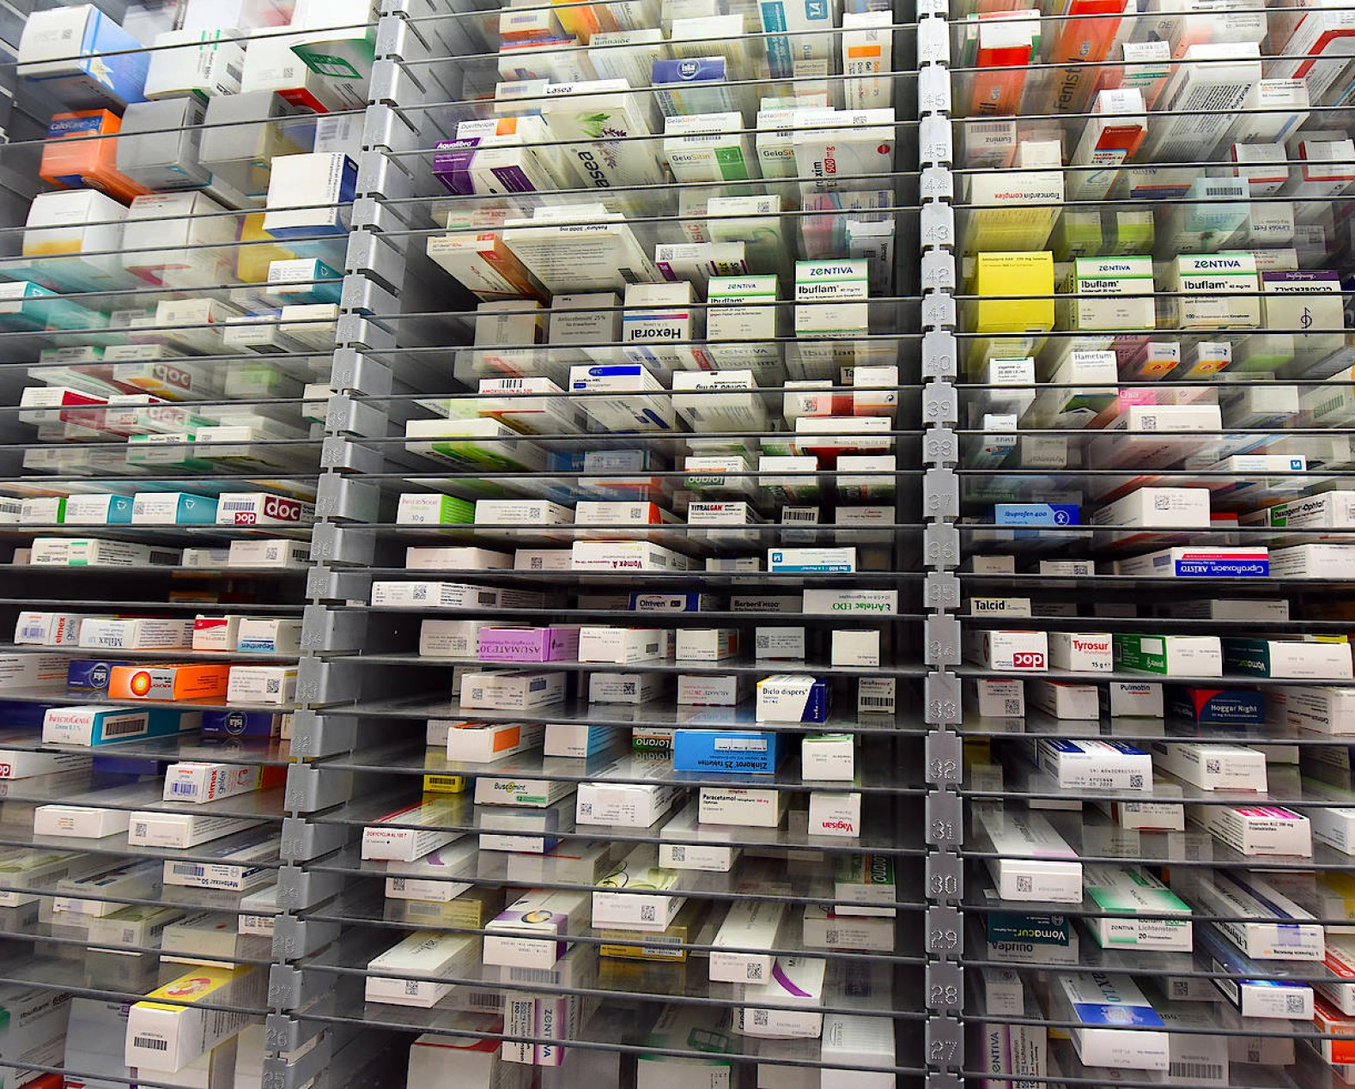
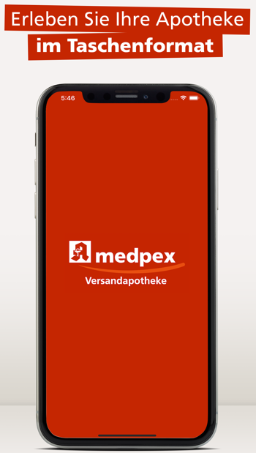
ONLINE
PHARMACIES
2018 online sales
USD 42 bil
2025 online sales
USD 107 bil
ZION MARKET RESEARCH (2018)

Slide 21
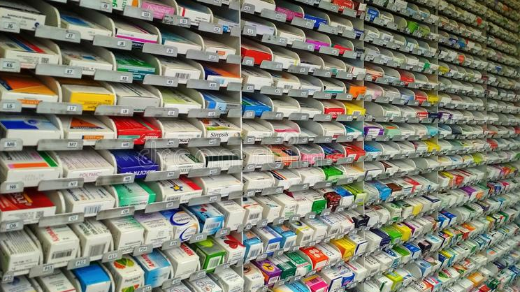
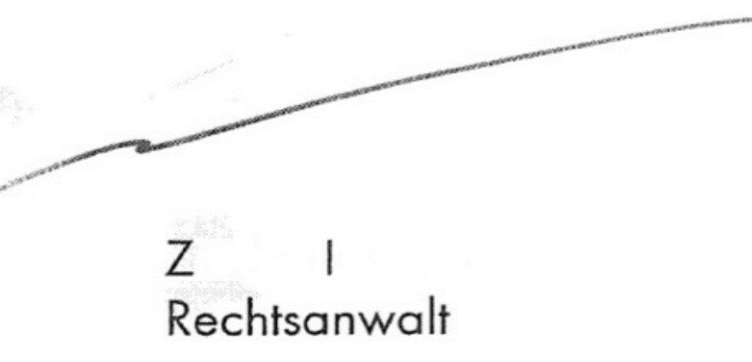
63%
of Germans wish to use e-prescriptions.
But only
23%
of pharmacists support the idea. (Schmittdiel et al, 2020)
Hi doctor!
Hi
How to read this?
It’s paracetamol 2x/day
How about this?
It’s amoxicillin 3x/day

Slide 22
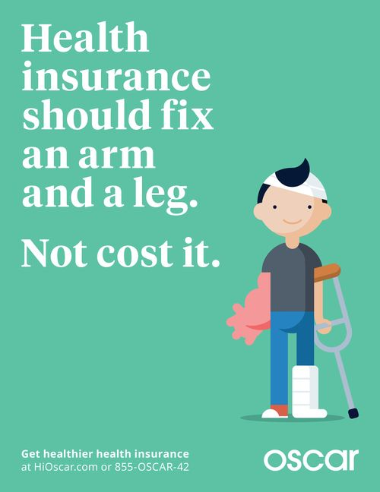
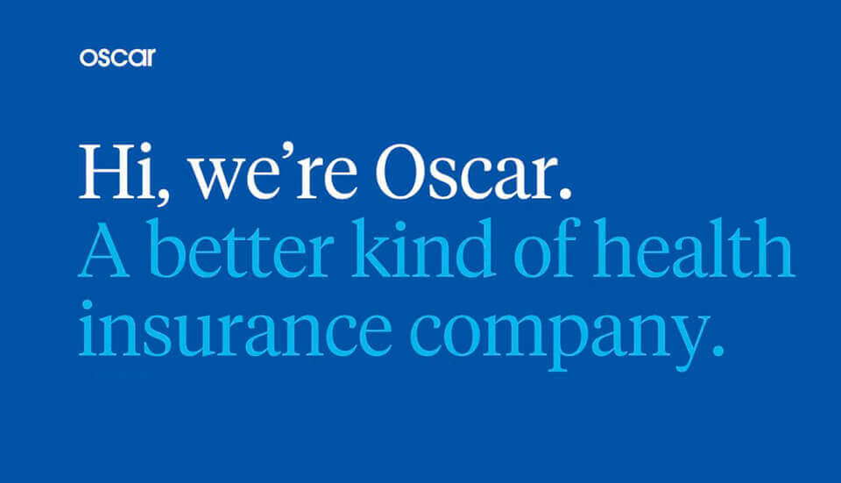
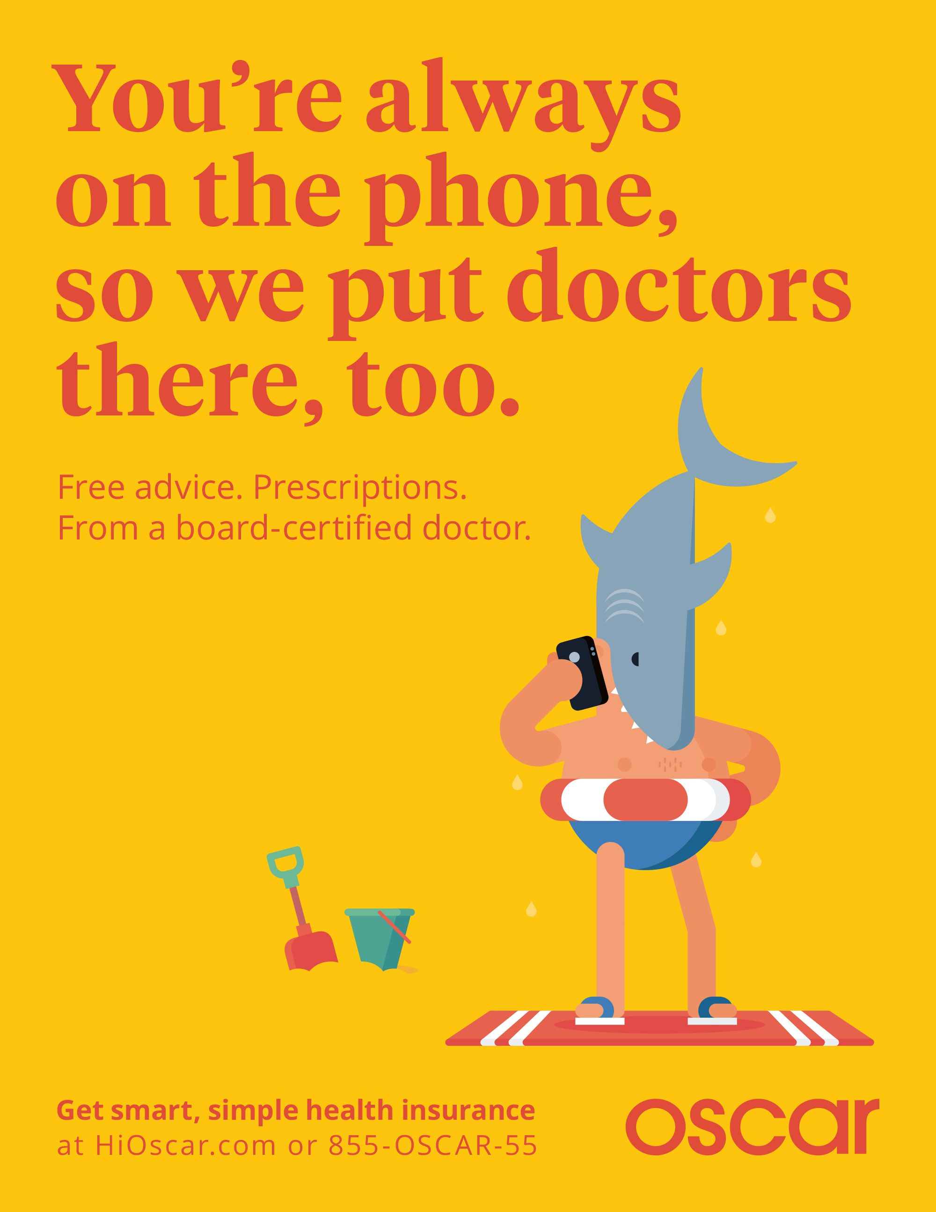
DIGITAL ONE-STOP PLATFORMS

Slide 23
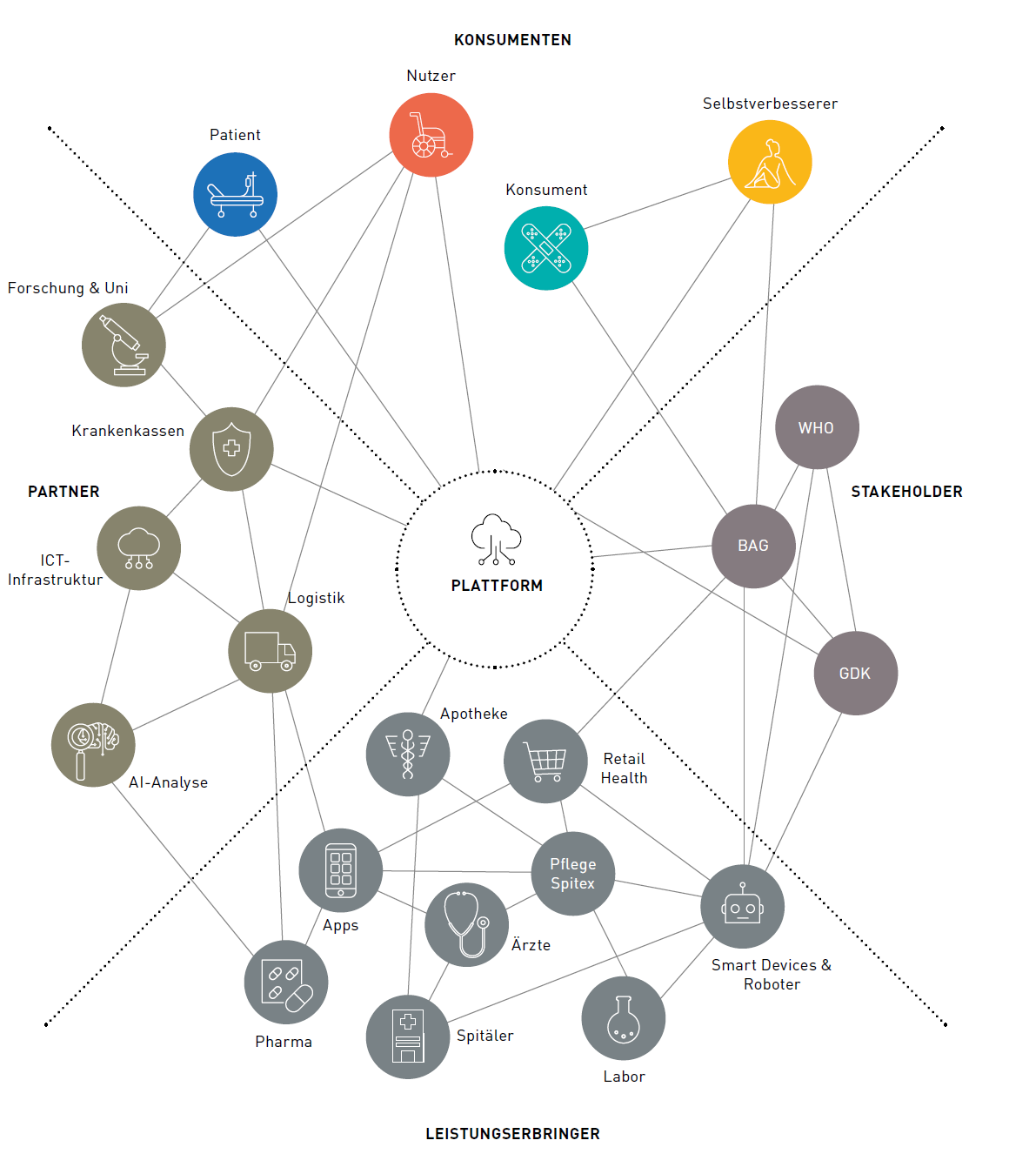
Model for an independent platform enabling the trust-worthy exchange of data between different parties.
Frick K, et al (2020) NEXT HEALTH Einfacher durch das Ökosystem der Gesundheit.
GDI – Gottlieb Duttweiler Institute, CH-Rüschlikon.

Slide 24
U.S. ADULTS who have a home broadband connection
HS Degree, or less
56%
College Degree
84%
Income USD ≤65t
62%
Income USD ≥65t
92%
Rural
63%
Suburban
75%
0%
100%
REF: Wall Street Journal; Pew Research Center (2019)

Slide 25
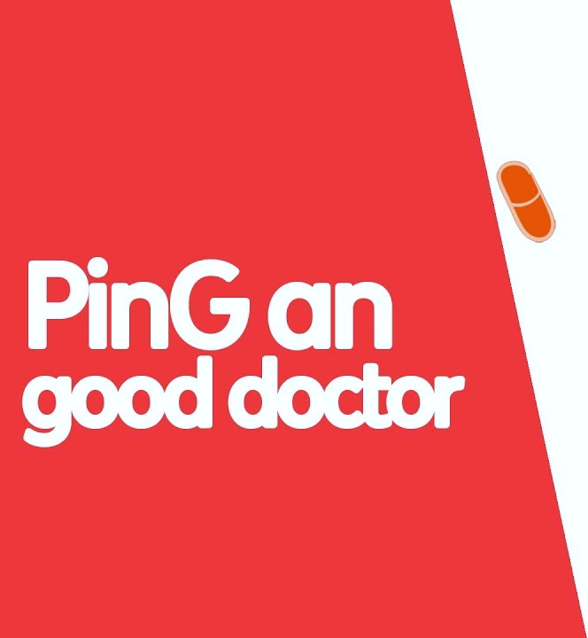
UNSTAFFED MINI-CLINICS
CHALLENGES
1.8 MD’s per 1’000 inhabitants (IND: 0.7 / USA: 2.5 / CHE: 4.2 / CUB: 8.2)*
avg. of 3h travel / waiting time to spend 8 minutes with MD
only little trust in local medical facilities
MD = Medical Doctor; *WHO (2019); PING AN GROUP 2021
350 million registered users (2020)
Ø 615’000 daily consultations

Slide 26
level of integration
interconnection of many different players
Daman
Ping An Good Doctor
e-Estonia
Helsenorge.no
WeDoctor
AliHealth
ShareCare
Kaiser Permanente
e-veseliba
connecting patient, doctor and pharmacy
NHS Spine
DXY.cn
mySugr
ELGA
Ocean Healthsystems
mDoc
Kanta
sundhek.dk
United Healthcare
Oscar
Tianjin Weiyi
DMP
TeleDoc
Chunyu Yiseng
DoctorUna
TrustedDoctor
Hao Dai Fu
connecting patient and doctor
TeleClinic
Vidavo
samedi
KRY
BoClinic
DoctoLib
U.S.A.
Gnosco
Meddy
Babylon Health
ADA
Gennev
Iryo
AbleTo
EUROPE
Vezeeta
FutureDocs
Maven
WebTeb
P.R.CHINA
Shiatech
specialized platforms with limited reach
connections for personal use
TalkSpace
Pager
MIDDLE EAST
So-Young
PatientsLikeMe
OTHERS, not part of study
# of connected participants (m)
1
5
10
50
100
200
300
REF: Choueiri P., et al (2020): Future of health II. FOCUS (9) ROLAND BERGER

Slide 27
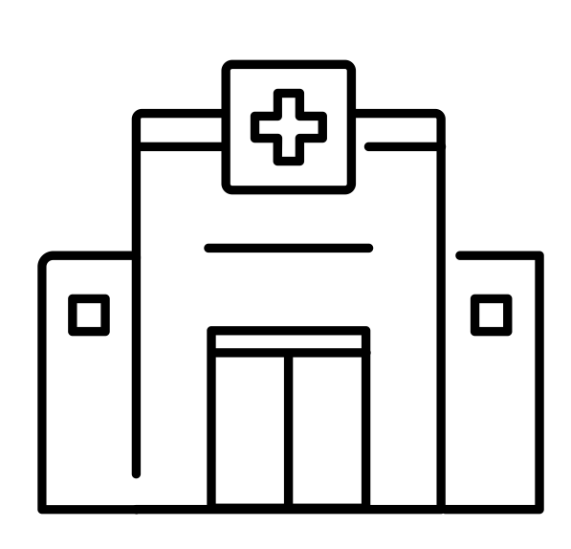
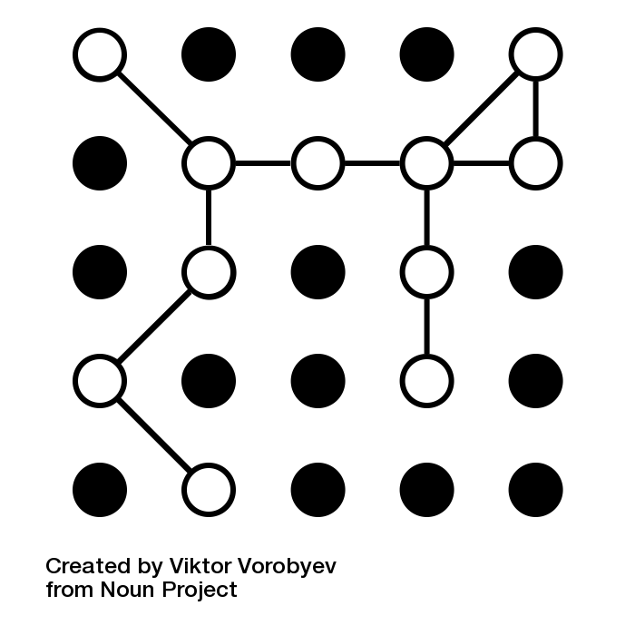
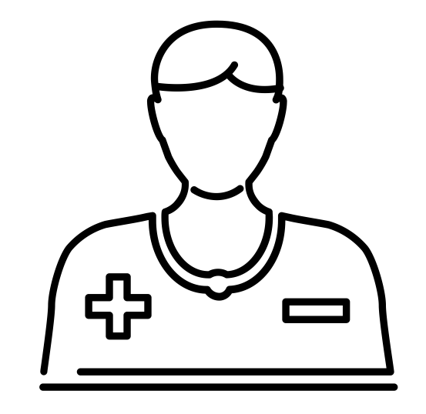
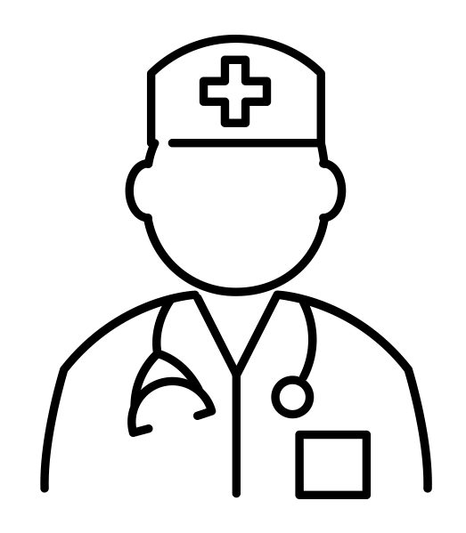
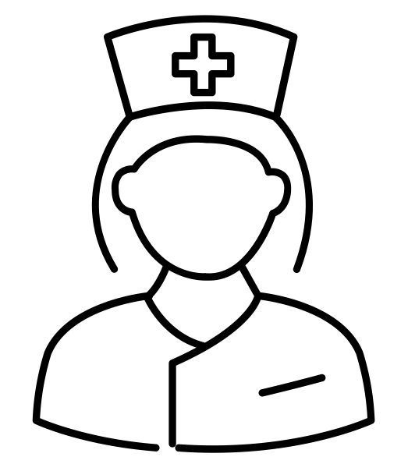
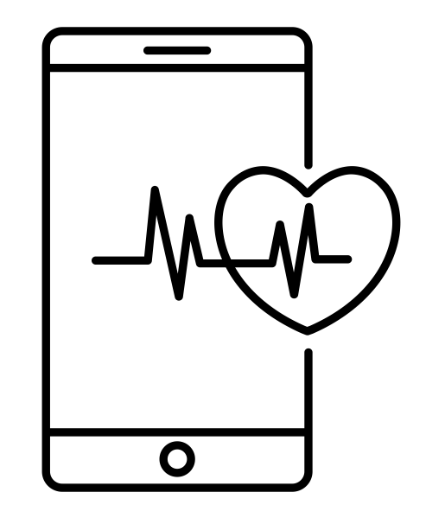
DIGITAL HEALTHCARE
REF: Fleisch E, et al (2021): The Digital Pill. EMERALD
A B C
manage data as a strategic asset
empower data-driven decisions
connect patients and care teams
build a learning health system

Slide 28
